Slide 1
Bias-Variance Tradeoff
and
Regularization

Slide 2
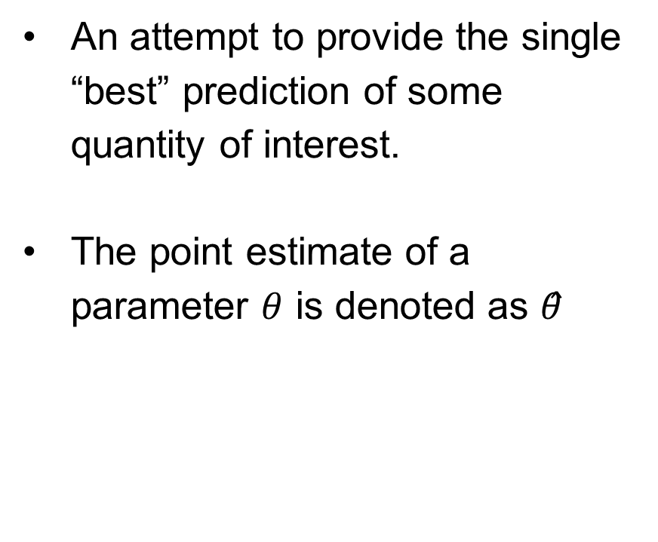
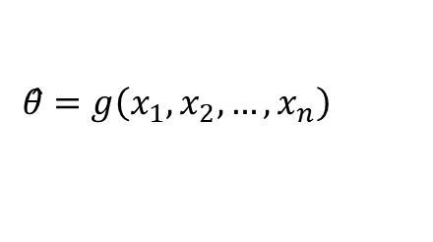


Point Estimation
An attempt to provide the single “best” prediction of some quantity of interest.
The point estimate of a parameter $θ$ is denoted as $θ̂$
$$θ̂=g\left(x_{1},x_{2},…, x_{n}\right)$$
$$θ=g(X)$$
$$x∈X$$

Slide 3
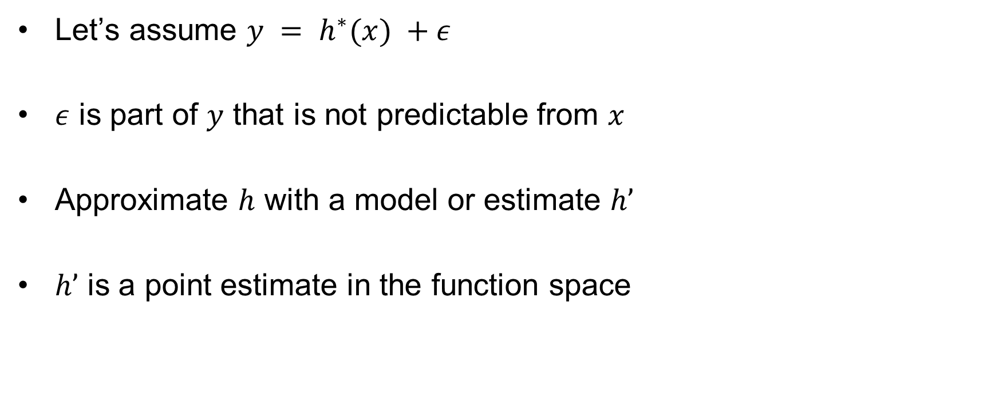
Function Estimation
Let’s assume $y = h^{∗}(x) +ε$
$ε$ is part of $y$ that is not predictable from $x$
Approximate $h$ with a model or estimate $h’$
$h’$ is a point estimate in the function space

Slide 4
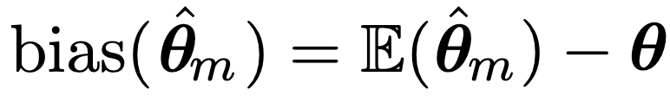


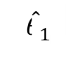


Bias and Variance
The bias of an estimator is deﬁned as
The variance of an estimator is simply the variance
$${\hat{θ}}_{2}$$
$${\hat{θ}}_{1}$$
$${\hat{θ}}_{3}$$
$$θ=g(X)$$
$$x∈X$$

Slide 5
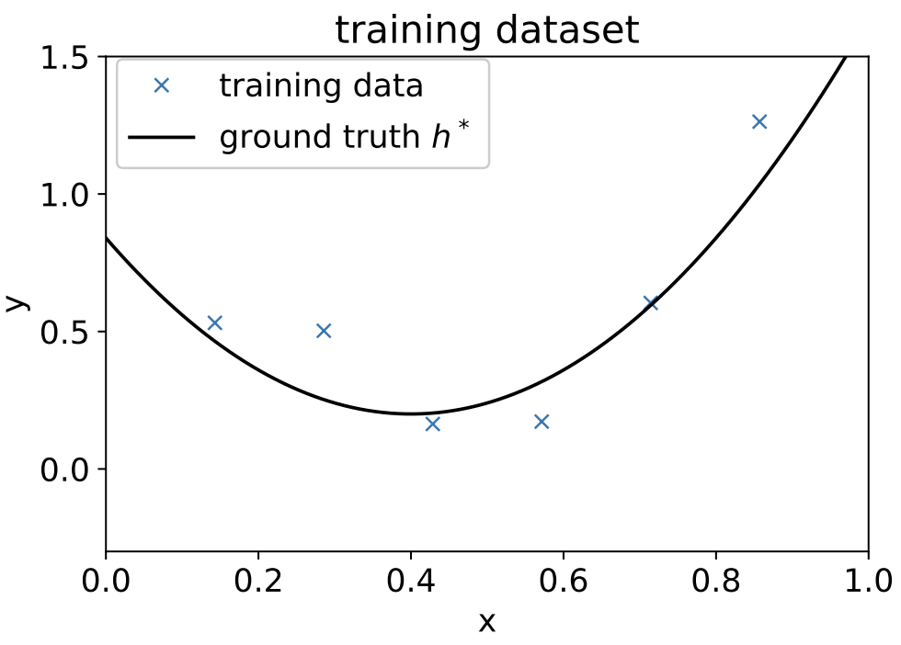
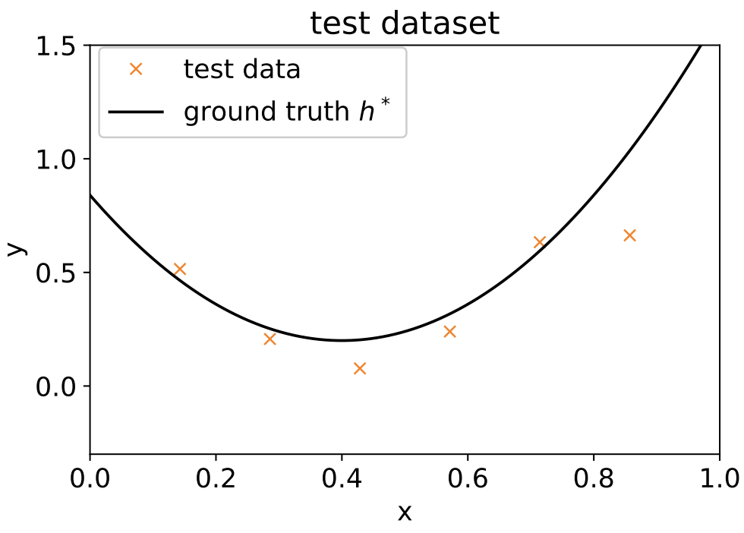
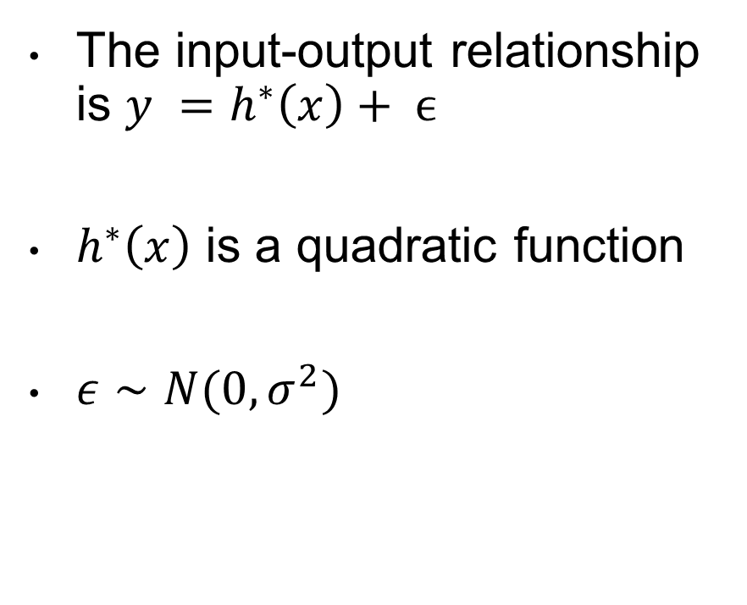
Bias-Variance Tradeoff
The input-output relationship is $y =h^{∗}\left(x\right)+ ϵ$
$h^{∗}\left(x\right)$ is a quadratic function
$ε∼N(0, σ^{2})$

Slide 6
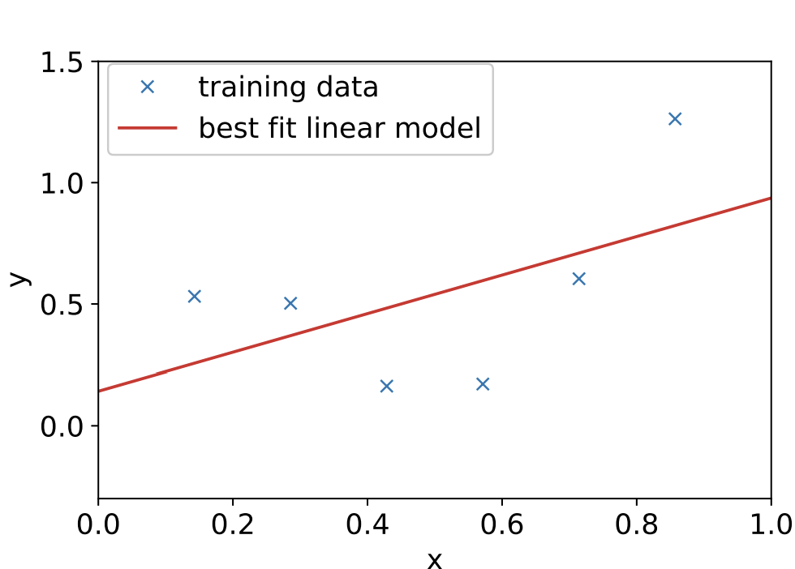
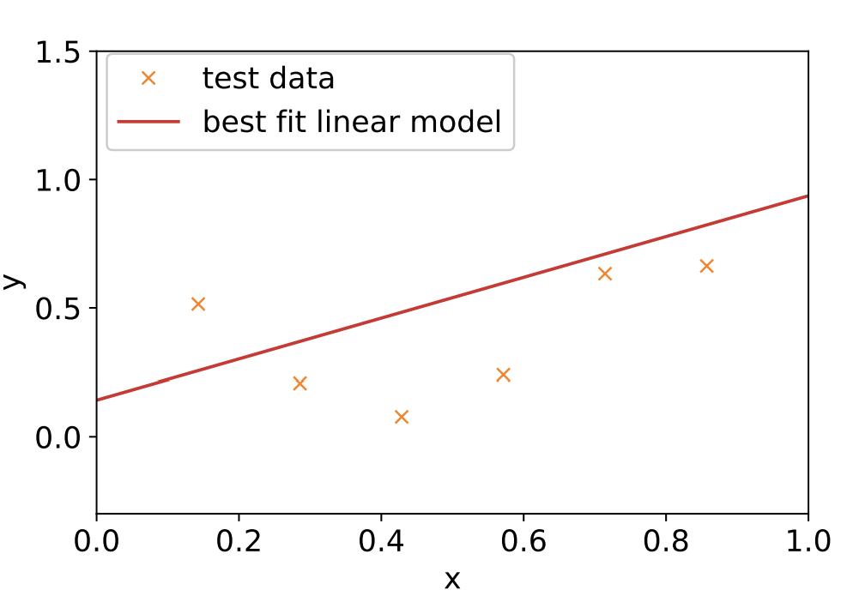
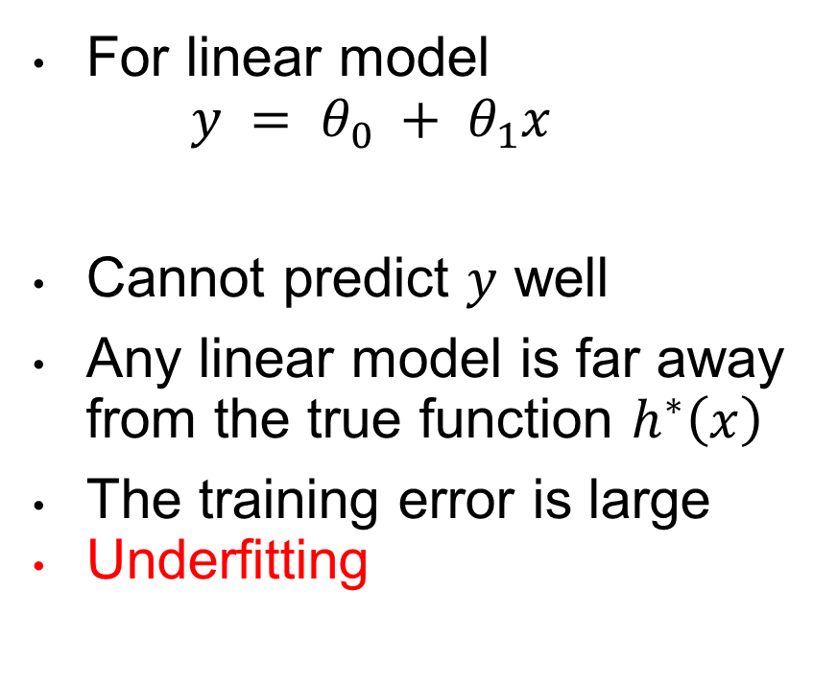
Bias-Variance Tradeoff
For linear model
$$y = θ_{0} + θ_{1}x$$
Cannot predict $y$ well
Any linear model is far away from the true function $h^{∗}\left(x\right)$
The training error is large
Underfitting

Slide 7
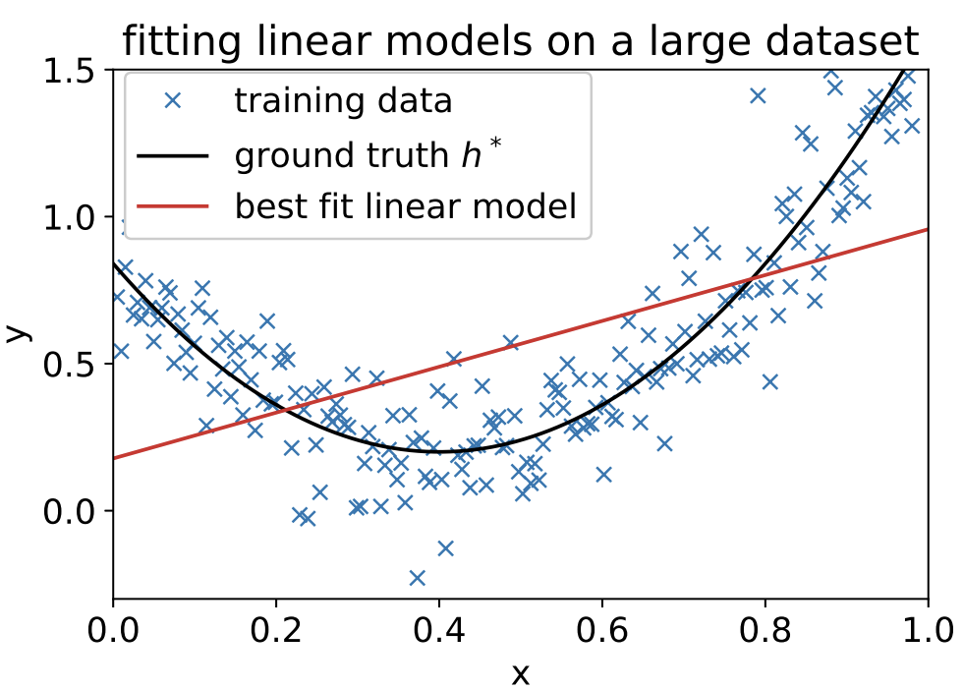
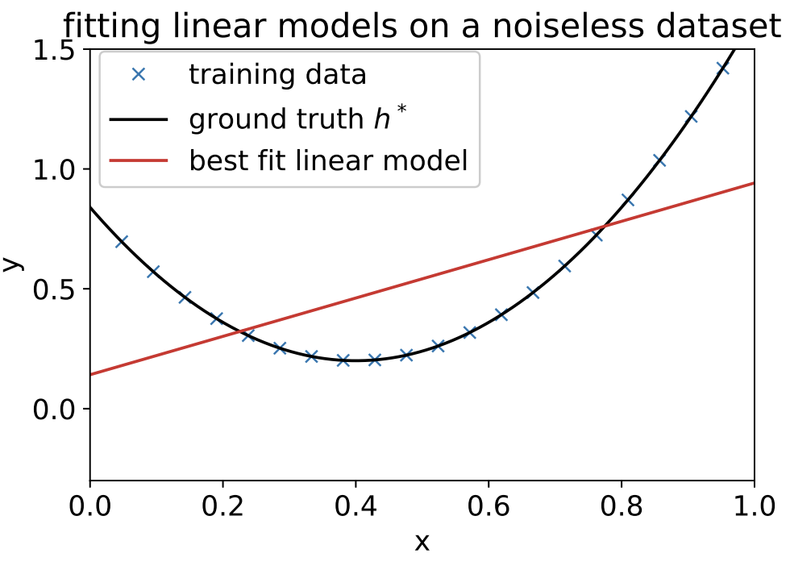
Bias-Variance Tradeoff
Cannot mitigate the issue with
large number of samples or
noiseless samples

Slide 8
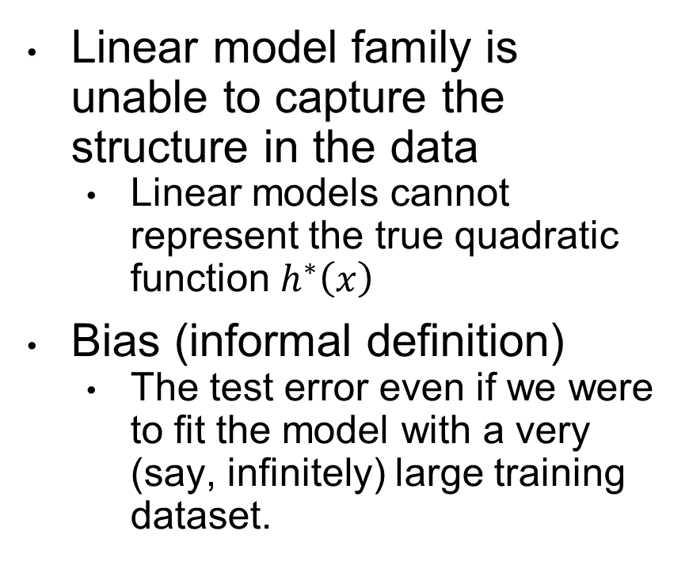
Bias-Variance Tradeoff
Linear model family is unable to capture the structure in the data
Linear models cannot represent the true quadratic function $h^{∗}\left(x\right)$
Bias (informal definition)
The test error even if we were to fit the model with a very (say, infinitely) large training dataset.

Slide 9
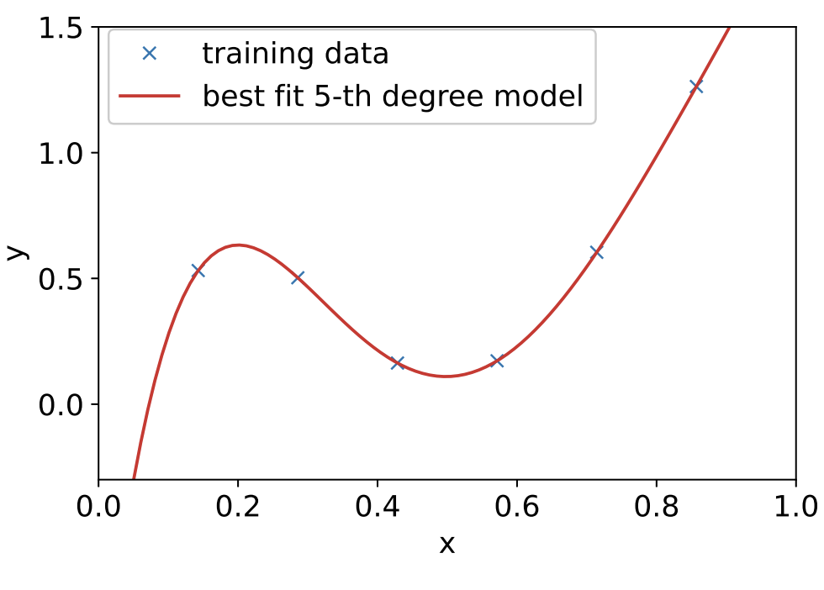
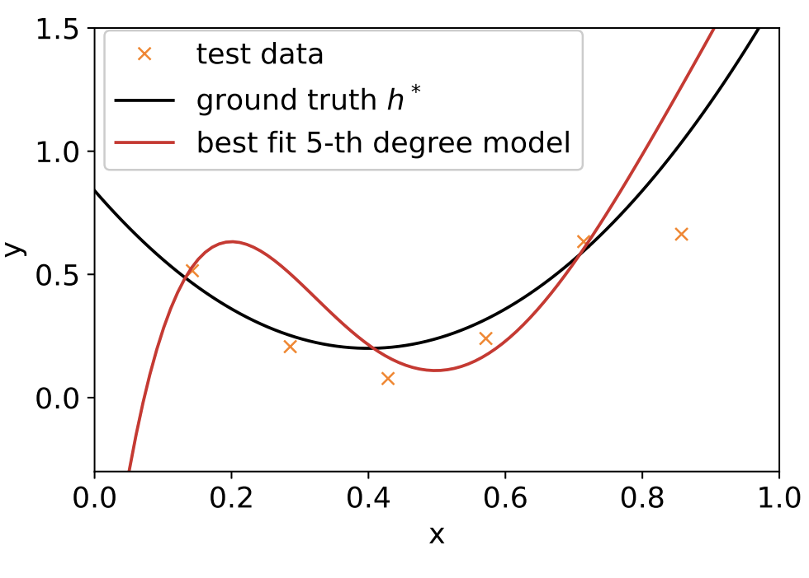
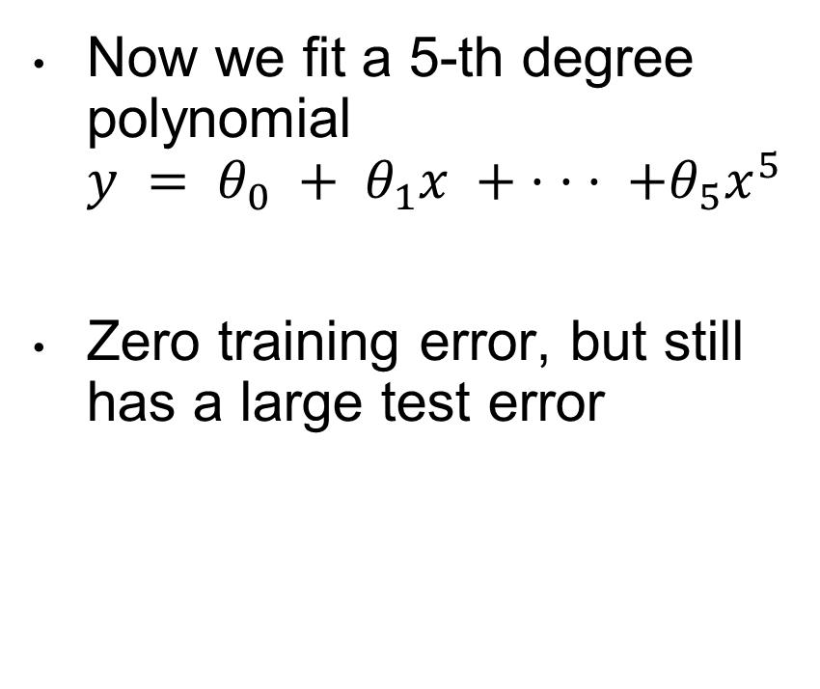
Bias-Variance Tradeoff
Now we fit a 5-th degree polynomial
$$y = θ_{0} + θ_{1}x + · · · +θ_{5}x^{5}$$
Zero training error, but still has a large test error

Slide 10
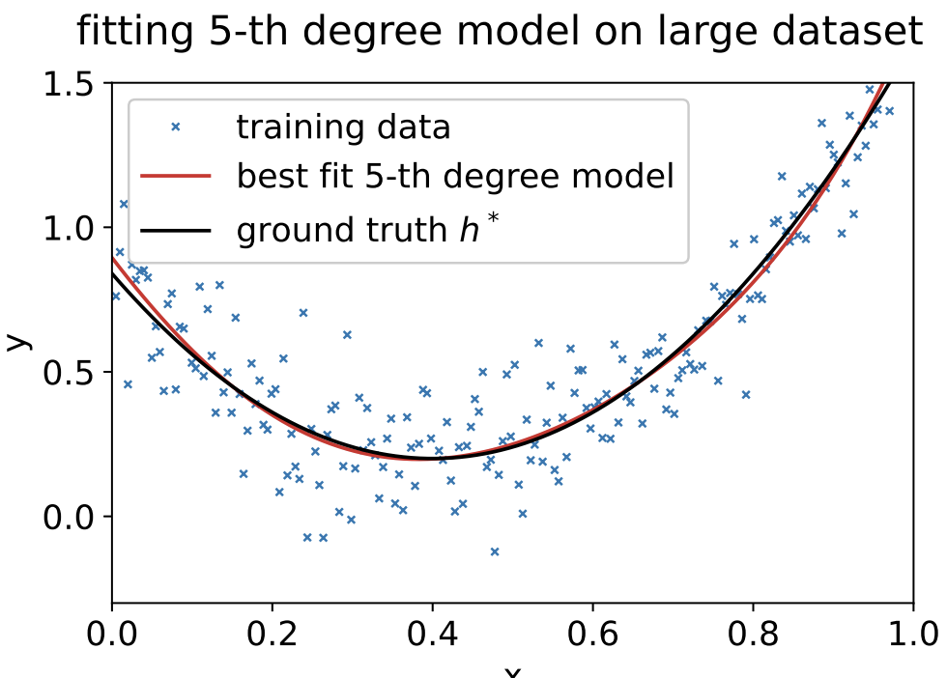
Bias-Variance Tradeoff
But huge dataset nearly recovers the ground-truth
Low Bias

Slide 11
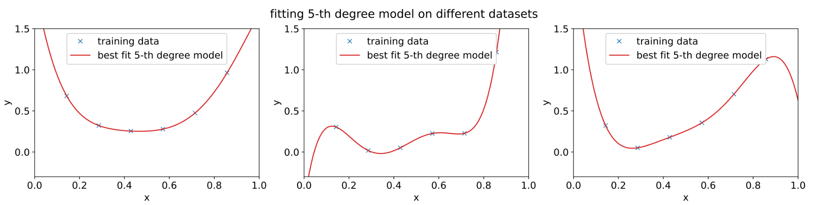

Bias-Variance Tradeoff
The issue with fitting a high-order polynomial is the variance of the model fitting process
Learning “spurious” patterns appearing in the small dataset from $ε$

Slide 12
Bias-Variance Tradeoff
Bias (informal definition)
The test error even if we were to fit the model with a very (say, infinitely) large training dataset.
Variance
The amount of variations across models learnt on multiple different training datasets (drawn from the same underlying distribution)

Slide 13
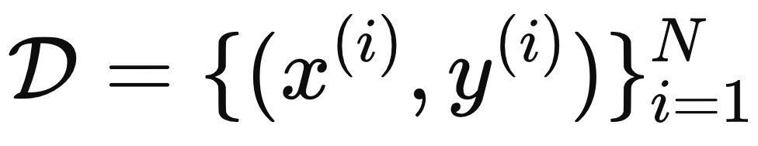
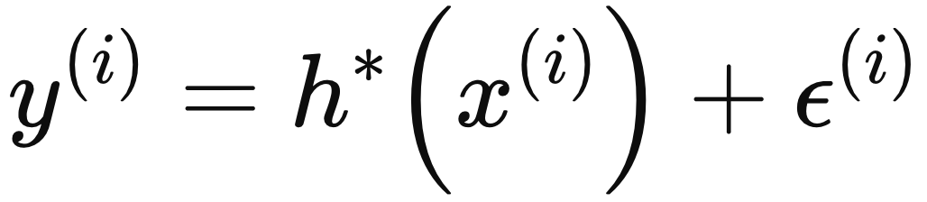
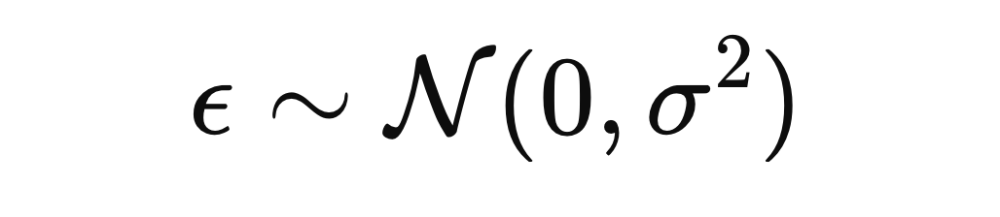
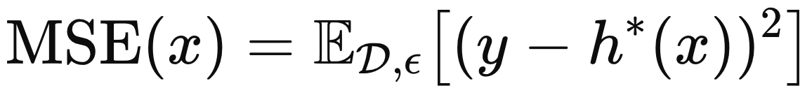
Bias-Variance Tradeoff (Mathematical Decomposition)
Given a training dataset,
The Expected Test Error,

Slide 14
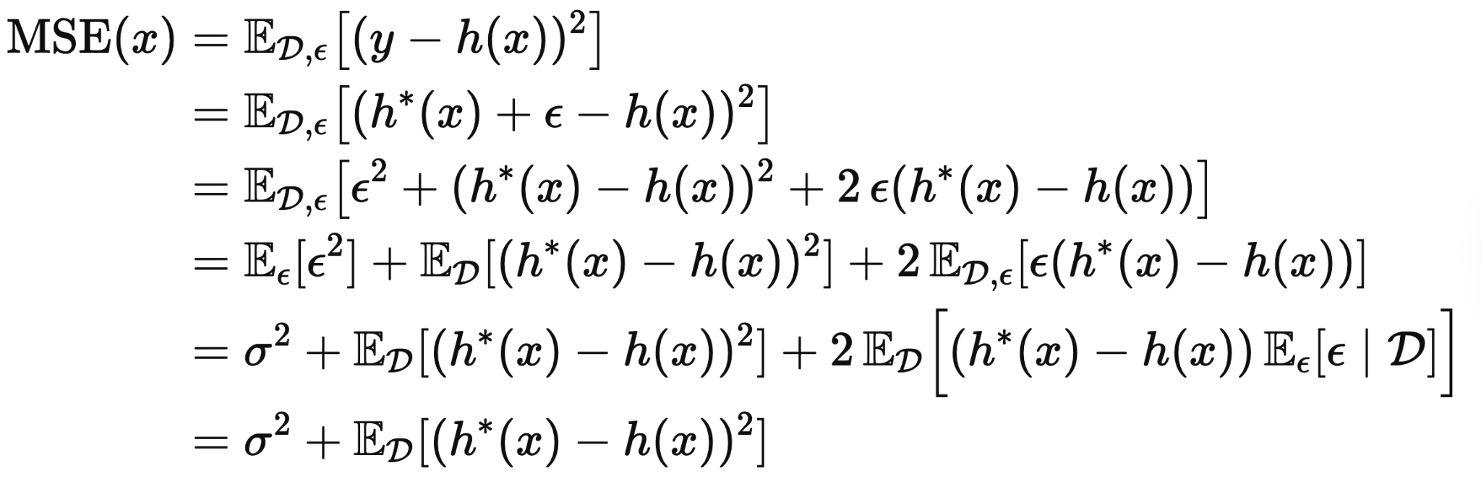
Bias-Variance Tradeoff (Mathematical Decomposition)
The Expected Test Error,

Slide 15
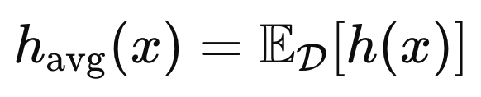
Bias-Variance Tradeoff (Mathematical Decomposition)
Let’s define,
We expand the term as follows,

Slide 16
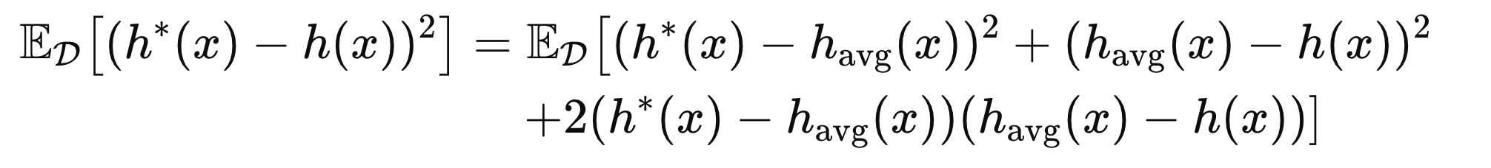
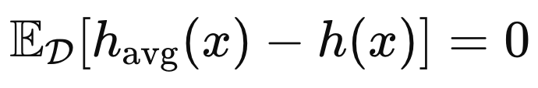
Bias-Variance Tradeoff (Mathematical Decomposition)
Expanding the expectation in a similar way we get,
Now,
So,

Slide 17
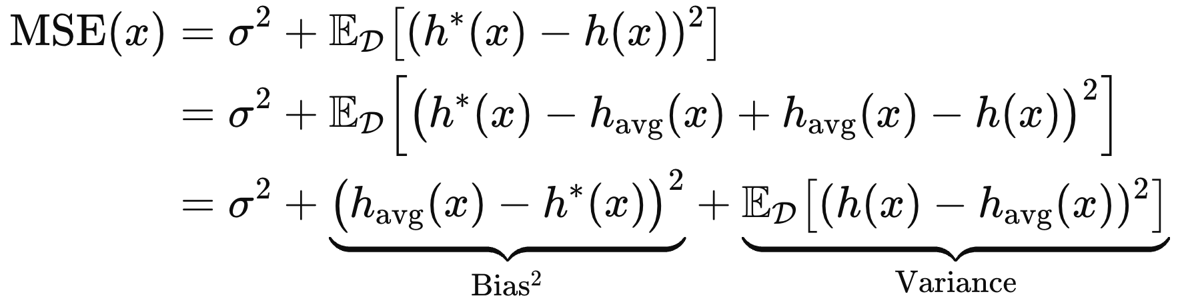
Bias-Variance Tradeoff (Mathematical Decomposition)
Combining everything,

Slide 18
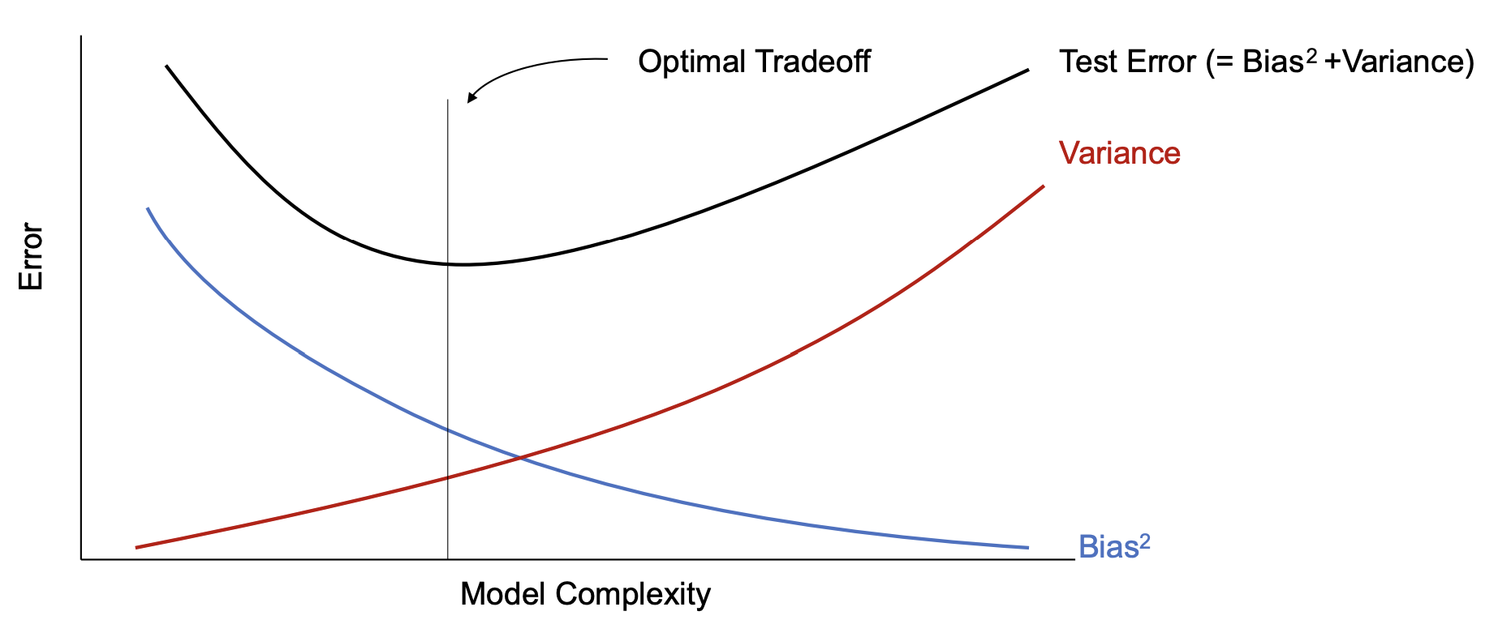
Bias-Variance Tradeoff

Slide 19
Regularization
Regularization is any modiﬁcation we make to a
learning algorithm that is intended to reduce its generalization error but not its training error.
Trade increased bias for reduced variance.
Take a model from the overfitting regime into the optimal trade-off regime

Slide 20
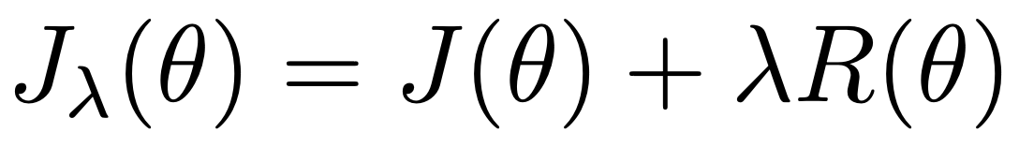
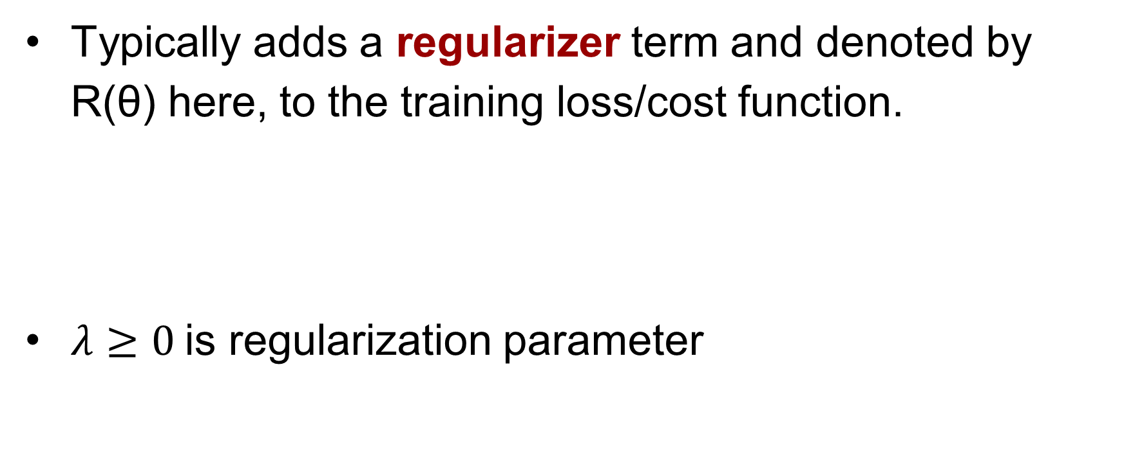
Regularization
Typically adds a regularizer term and denoted by R(θ) here, to the training loss/cost function.
$λ≥0$is regularization parameter

Slide 21
Regularization
Goal
Reduce some measure of model complexity
Put constraints on the model parameters
Encode prior knowledge
Prefer simpler models
etc.

Slide 22
Parameter Norm Regularizer
L-2 regularization
Also called weight decay or ridge regression
L-1 regularization
Also called Lasso

Slide 23
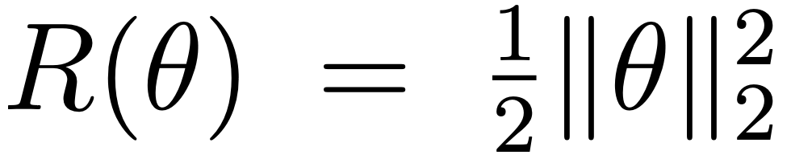
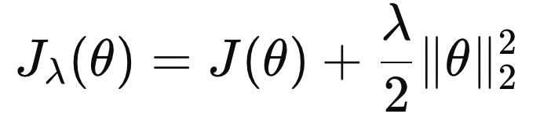
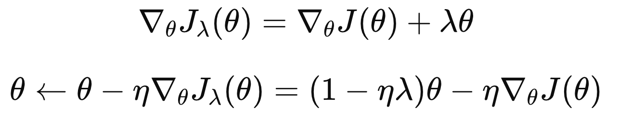
L-2 Regularization
Add a squared L-2 norm of the parameters as the regularizer to loss/cost function.
We can derive the update equation of gradient descent,
Reduces the weight

Slide 24
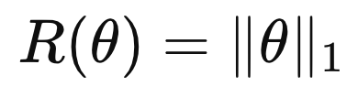
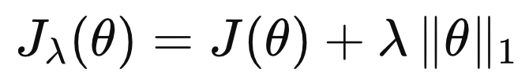
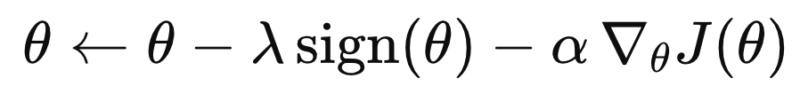
L-1 Regularization
Add L-1 norm of the parameters as the regularizer to loss/cost function.
We can derive the update equation of gradient descent,
Introduces sparsity

Slide 25
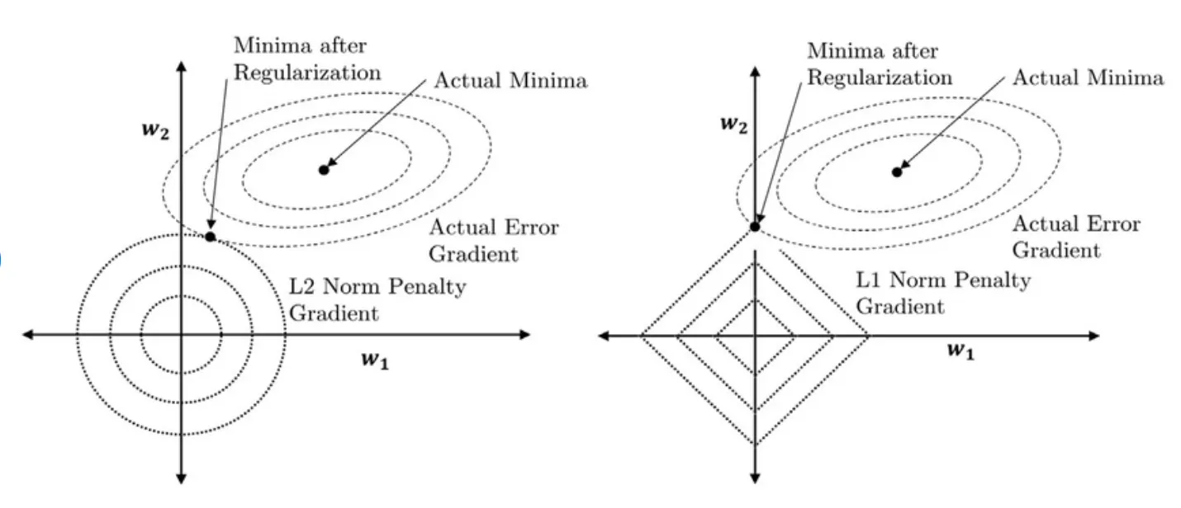
Interesting Facts
L2 and L1 regularization corresponds to MAP estimation under a zero-mean Gaussian prior and Laplacian priors respectively
L-1 regularization leads to sparsity of the parameters

Slide 26
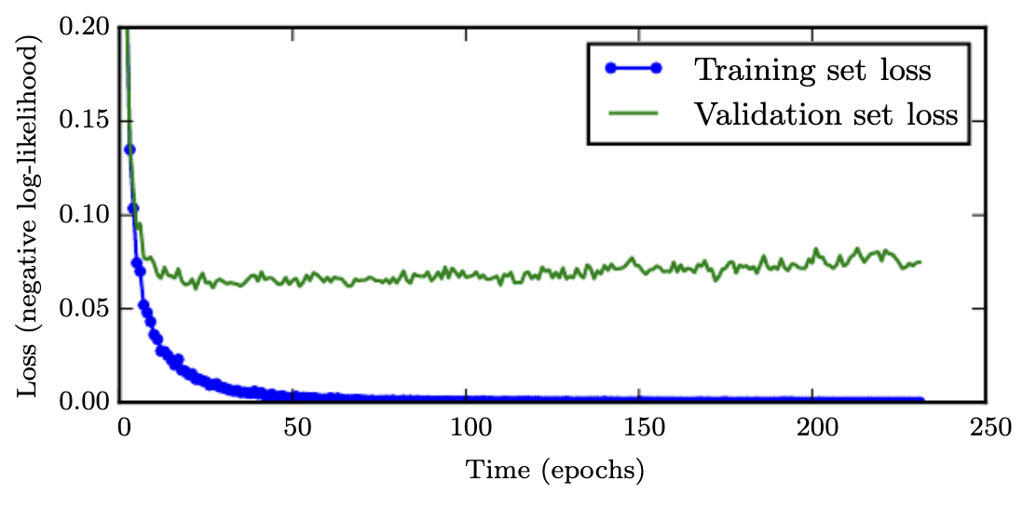
Early Stopping
We often observe,
Training error decreasing over time
But validation error begins to rise
Store a copy of the model parameters, every time the validations error improves
Terminate training when validation error hasn’t improved for some pre-speciﬁed number of iterations.
Return the model parameters corresponding to the best known validation error

Slide 27
Reference
CS229 Lecture Note
Section 8.1, 9.1
Deep Learning Book
Section 5.2.2, 5.4.1-5.4.3
Section 7.1.1, 7.1.2, 7.8
D2L
Section 3.6, 3.7, 5.8

